Slide 1
Earth and Human Activity
Earth Science

Slide 2
Intro to Energy Resources

Slide 3
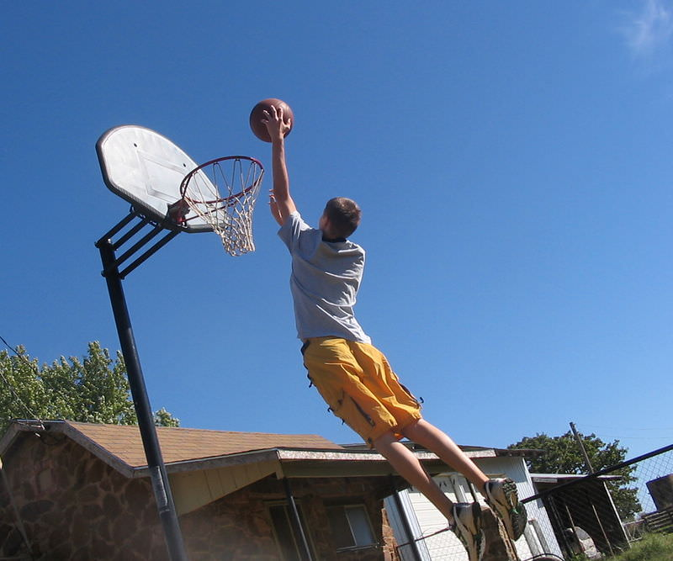
Where is this basketball player getting his energy?

Slide 4
Kinetic Energy
http://www.youtube.com/watch?v=v-Z2-jxCqVw (6:01).

Slide 5
Potential Energy
http://www.physicsclassroom.com/mmedia/energy/se.cfm
http://www.physicsclassroom.com/mmedia/energy/ce.cfm
http://www.physicsclassroom.com/mmedia/energy/dg.cfm

Slide 6
Summary
Energy is the ability to do work. Energy cannot be created or destroyed; it can only change form.
Fuel stores energy that can be released during use.
Heat is the motion of atoms due to the use of energy.

Slide 7
Making Connections
https://www.thinglink.com/scene/274579781591236608

Slide 8
Practice
https://www.youtube.com/watch?v=LIh9ueO9FBM
How can the energy of a weight at the top of a pulley be transferred into heat in a tub of water? List the types of energy involved.
What is true about energy in a closed system?
What are the two things that energy can become in a closed system?
Where is the energy to drive a car stored and what type is it? What type of energy does that become?

Slide 9
Obtaining Energy Resources

Slide 11
Summary
Net energy is the amount of that is actually useable from an energy resource. Net-energy ratio is the ratio of the amount of useable energy from a resource and the amount it takes to make that energy useful.
Many factors besides net-energy ratio go into determining if a type of energy will be used.
An energy source with high energy efficiency provides a lot of work for the amount of energy used.

Slide 12
Practice
Use this resource to answer the questions that follow.
How to save money and energy: http://www.youtube.com/watch?v=VC3C_8eQgeE
Besides energy, what is lost when energy drips away?
Why should you replace incandescent bulbs with CFLS?
Why is it good to plug electronics into a power strip?
Why should you use a programmable thermostat?
What is the purpose of insulation?
Why is an old appliance an energy sink?
If you did these things, how much money would you save in a decade on average (in Minnesota)?

Slide 13
Review
Compare and contrast net energy, the net-energy ratio, and energy efficiency.
Since the net-energy ratio for solar energy is higher than other types of energy, why don't we use solar for electricity almost exclusively?
Why would the energy needed to make a type of energy useful increase or decrease? In other words, why would the net-energy ratio change?

Slide 14
Making A Top Energy Efficient Home
https://youtu.be/cP2Hm4rzuFI
This video is about the energy efficiency part of the concept. It shows how some contractors have built an extremely energy efficient home. Efficient buildings waste less energy, last longer, and ultimately cost much less than inefficient buildings.

Slide 15
Majestic Plastic Bag
https://youtu.be/GLgh9h2ePYw
What’s true?
What’s exaggerated
Which are there for entertainment value

Slide 16
How was the GPGP caused?
Why is the GPGP so problematic?
How could this have been avoided?
What are "nurdles" and how do they affect the GPGP?
What can we do to solve this problem?
What is the most important thing you took from the videos today?

Slide 17
https://youtu.be/ROW9F-c0kIQ
https://youtu.be/b5eX-J23_oE
Would these ideas work?
Do some research

Slide 18
Types of Plate Boundaries
Convergent: plates moving towards each other. Mountains occur here
Divergent: plates moving away from each other. Volcanoes occur here
Transform: plates slide horizontally creating friction. Earthquakes occur here at fault lines

Slide 19
Everything on your test will be directly from the notes and packets!
Not all of the packets/information are included in this Power point, so use your notes!

